Slide 1
Top 10 C-Suite Hospital Watch List - Are These Technologies and Trends on your Radar? SEPAC Philadelphia, PA
November 15, 2016
Thomas E. Skorup, MBA, FACHE
Vice President, Applied Solutions

Slide 2
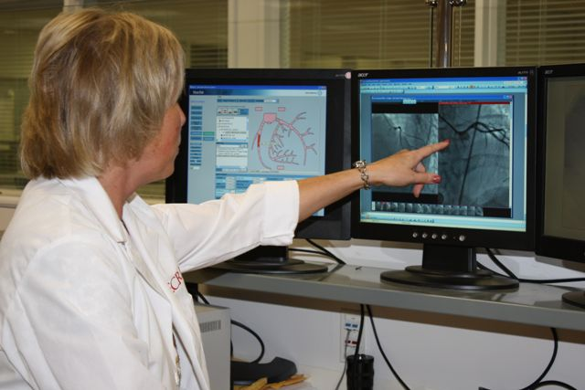
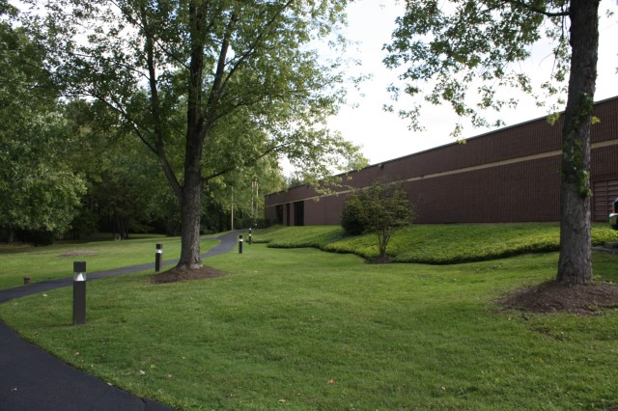
ECRI Institute
Independent and research driven international nonprofit
Strict conflict-of-interest rules
World class experts improving patient care, mitigating decision risk on technology & providing cost avoidance solutions
Federally certified patient safety organization and evidence based practice center - Agency for Healthcare Research and Quality

Slide 3
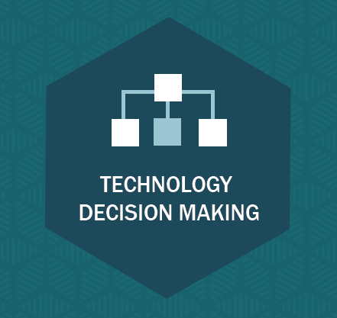
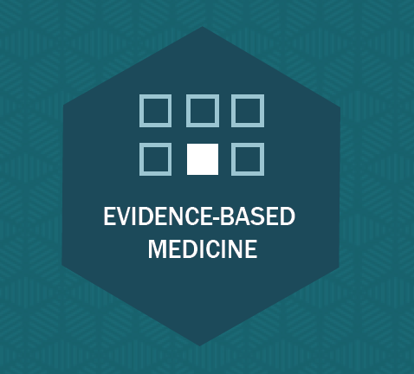
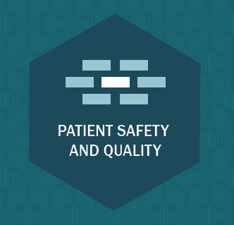
ECRI Institute
Pricing, performance, equipment planning, market intelligence, and analytics
Evidence-based recommendations, and technology planning
Risk management, problem reports, standards, and guidelines

Slide 4
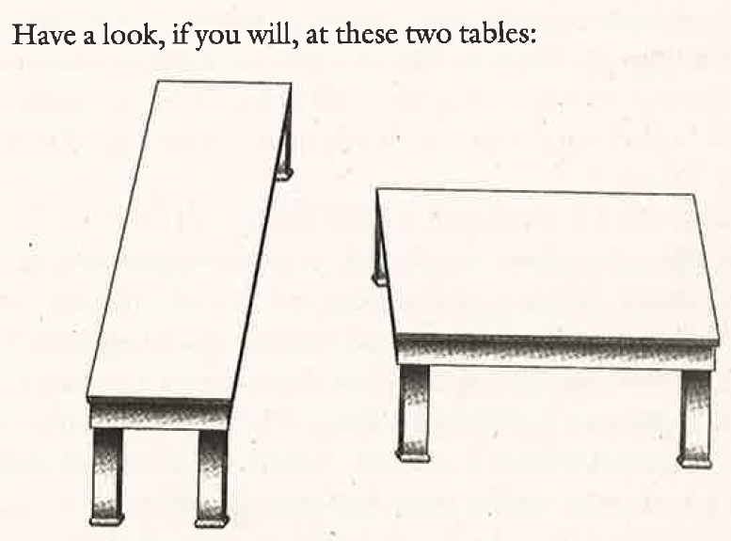
Source: Nudge: Improving Decisions About Health, Wealth, and Happiness. Thaler and Sunstein, 2009. Page 17.
Notes:
Which one of these tables is a bench and which is a coffee table?

Slide 5
The first principle is that you must not fool yourself and you are the easiest person to fool.
--Richard P. Feynman*
* Richard Feynman was a prominent American scientist, widely considered to be one of the greatest and most influential theoretical physicists in history. Feynman revolutionized the field of quantum mechanics and formulated the theory of quantum electrodynamics. He won the Nobel Prize for Physics in 1965.

Slide 6
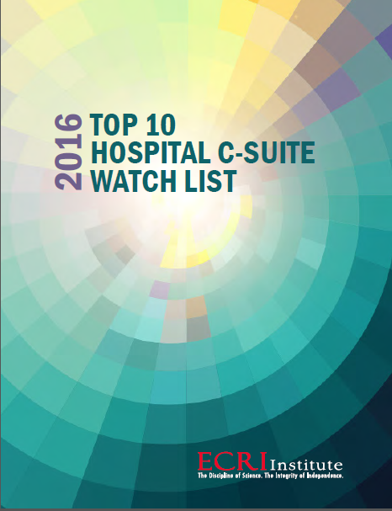
History of the Top 10 C-suite Watch List
ECRI experts polled for topics regarding….
Something newsworthy
The potential to positively impact patient
outcomes in major illnesses, diseases, or injuries
Ready or near ready for implementation
Turf wars or, conversely, improved collaboration
Improving patient and staff safety
A marketplace differentiator
Voted on nominated topics

Slide 7
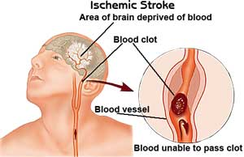
1. Mobile Stroke Units
WHAT ARE THEY?
A specially outfitted ambulance with:
Telemedicine capabilities for consultation with a vascular neurologist
Portable CT scanner
Blood testing equipment
Special staffing: Critical care nurse CT technologist
THE NEED
Tissue plasminogen activator (tPa) often is not administered, as too much time has elapsed since onset of stroke symptoms.

Slide 8
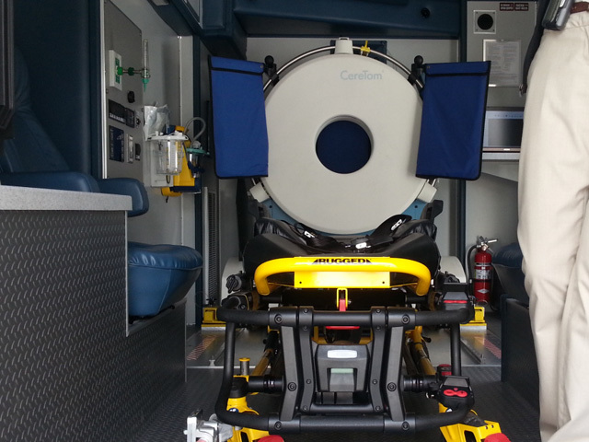
1. Mobile Stroke Units
CONCERNS
Cost of the special ambulance and equipment estimated to be >$400K, with operating costs representing another $1M to $1.2M annually
If symptoms are too mild, the patient is too sick, or the condition mimics hypoglycemia, seizure, migraine, or other psychiatric conditions, tPA may not be administered, and care reverts back to the regular EMS
Requires tight integration with regional stroke centers

Slide 9
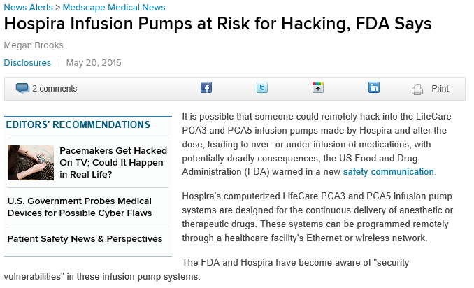
2. Medical Device Cybersecurity
CONCERNS
Medical devices may serve as a vector to protected health information and/or institutional or patient financial information
While policy and cybersecurity may be in place for the electronic medical record, many hospitals cannot identify what operating software is running on their thousands of medical devices
Physiologic monitor running outdated operating system
Ventilator with a USB port
Inadequate password management
Medscape Medical News

Slide 10
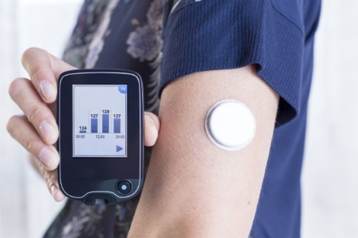
3. Wireless Wearable Sensors
WHAT IS IT?
Wireless miniature sensing and data collection devices that may be integrated into clothing, worn as accessories, or adhered to the skin
Measure biologic/chemical/physical phenomena to indicate change in patient status
THE NEED
In addition to fitness tracking, how can wearable sensors be utilized to improve cost-effectiveness and safety of acute and chronic patient care?

Slide 11
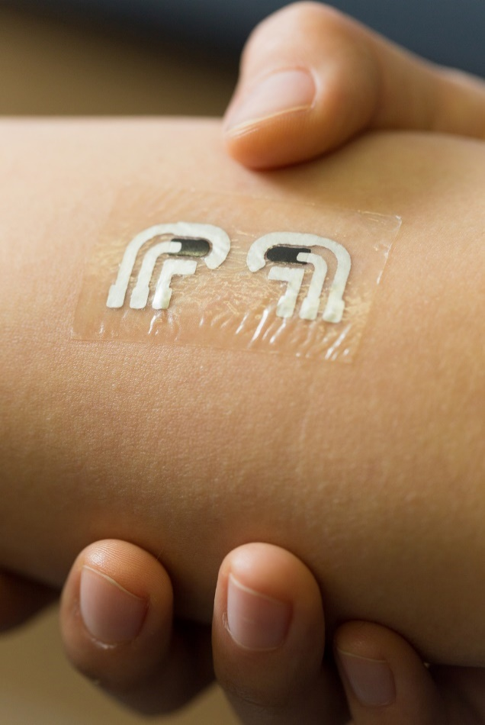
3. Wireless Wearable Sensors
SOME NOVEL APPLICATIONS
Pressure Ulcer Prevention – having a patient with a wearable sensor led to an increase in turning protocol compliance from 64% to 98%
Neurologic function – using motion sensors and combining data, detailed insights can be obtained on gait, falls, tremor, dyskinesia and paralysis
Heart failure – a “necklace” device can be worn to measure thoracic bioimpedance and ECG, which are used to calculate thoracic fluid index, heartrate variability

Slide 12
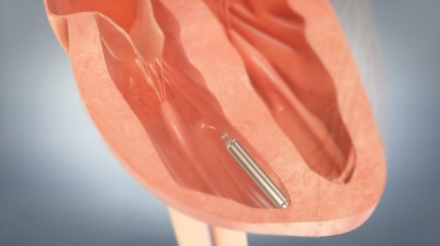
4. Miniature Leadless Pacemakers
THE NEED
About 4% of patients with pacemakers encounter device-related complications, including lead migration or failure, or implant-related infection
Next-generation pacemakers in development are less than 10% the size of conventional pacemakers, leadless, and do not require surgery to implant

Slide 13
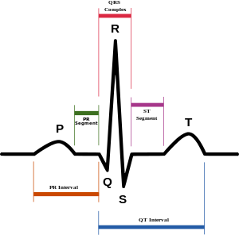
4. Miniature Leadless Pacemakers
WHAT ARE THEY
These devices are able to sense and pace in only one heart chamber, so they are considered appropriate for only about 15% of patients requiring a pacemaker
The hope is that this new generation of pacemakers will improve safety, comfort, and quality of life for some patients compared to existing pacemakers
St Jude Medical – Nanostim™ Leadless Pacemaker
Medtronic – Micra™ Transcatheter Pacing System (TPS)

Slide 14
4. Miniature Leadless Pacemakers
EVIDENCE
Late-phase clinical trials are underway to obtain FDA approval
Both devices have received the European Union CE mark and are in use there
Long-term safety remains a concern as the ability to remove an implanted device over the longer term (e.g., battery depletion in 10 years) remains untested in humans

Slide 15
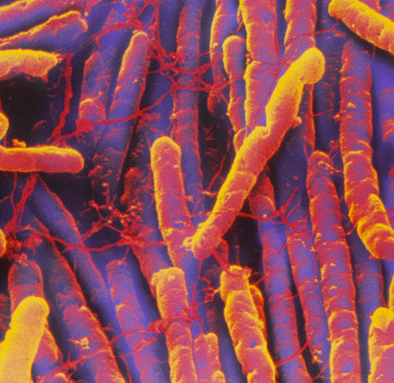
5. Blue-violet LED Light Fixtures
WHAT IS IT?
Another disinfection tool in addition to environmental surface disinfection techniques and use of UV light robots
Indigo-Clean High-Intensity Narrow-Spectrum Light Environmental Disinfection System continuously emits a blue-violet light that has antibacterial and antiviral activity

Slide 16
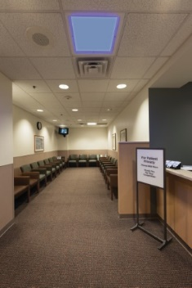
5. Blue-violet LED Light Fixtures
THE NEED
Healthcare-acquired infections (HAIs) are a major cause of morbidity, mortality, healthcare costs, and reimbursement penalties
According to CDC, 100,000 deaths and $28B-$45B in costs are attributed to HAIs in the U.S. each year
CONCERNS
A single HAI can increase length of stay > 19 days (according to U.S. Healthcare Cost and Utilization project)

Slide 17
6. New High-cost Cardiovascular Drugs
THE NEED
10% - 20% of the 34M Americans with very high cholesterol cannot tolerate high statin doses
Congestive heart failure rates remain high, even with angiotensin treatments (e.g., ACE)
WHAT ARE THEY?
PCSK9 inhibitors (Praluent™ and Repatha™) are injectables that enable the liver to get rid of bad cholesterol
Entresto™ is approved to treat patients with NY Heart Association class II-IV heart failure

Slide 18
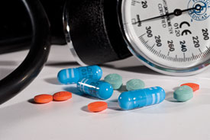
6. New High Cost Cardiovascular Drugs
CONCERNS
Each new drug is expensive compared to existing standard-of-care medications
Annual cost of Repatha™ is expected to be about $14,500; Entresto™ would be about $4,500 annually
Institute for Clinical and Economic Review found that these drugs would be cost-effective at about 15% of current pricing schemes
If they keep patients out of the hospital, might they prove cost-effective?

Slide 19
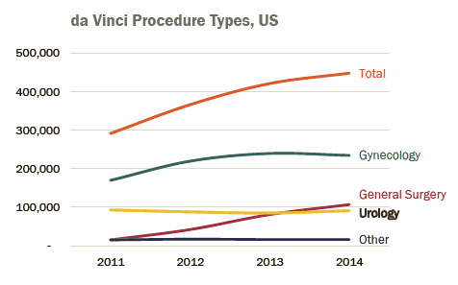
7. Changing Landscape of Robotic Surgery
THE ISSUE
Robotically assisted general surgery cases are growing rapidly compared to robotically assisted laparoscopic prostatectomy and hysterectomy surgeries
da Vinci S: End of life in December 2017
Intuitive has introduced the da Vinci Xi platform that competes with its da Vinci Si and Si-e platforms

Slide 20
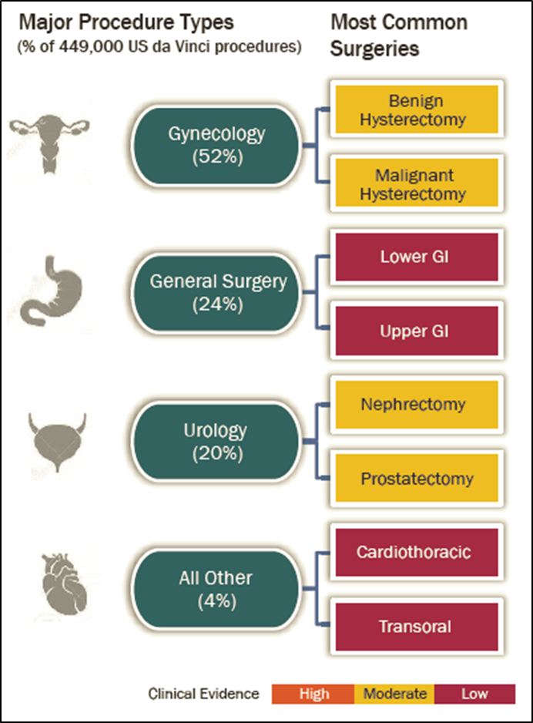
7. Changing Landscape of Robotic Surgery
CONCERNS
Diffusion of new procedures in the absence of evidence supporting better patient outcomes
Increasing number of new surgeons with robotic fellowship and residency training
Increased cost per case of about $1,500 for robotically assisted procedures.

Slide 21
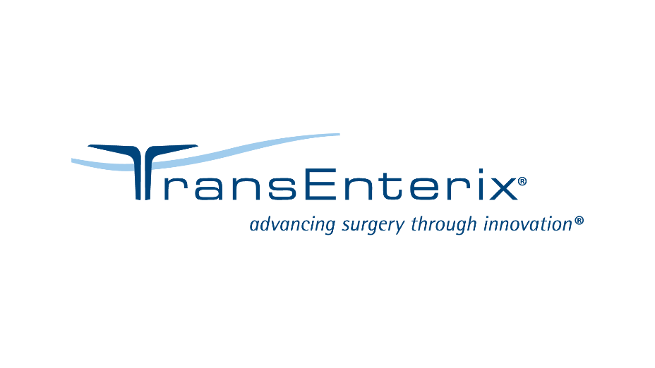
7. Changing Landscape of Robotic Surgery
FUTURE COMPETITION
Titan Medical SPORT™ (Single Port Orifice Robotic Technology™)
TransEnterix SurgiBot™
Both are focused on single-site surgery robotic systems designed to be less expensive than da Vinci models
Verily (formerly Google Life Sciences) and Ethicon announce partnership focused on leading-edge robotics in surgery
Verb Surgical in December 2015

Slide 22
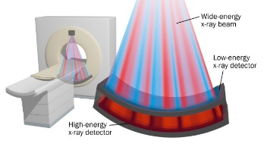
8. Spectral CT
WHAT IS IT?
Spectral CT separates the energy band of x-rays into two or more narrow energy bands, which are each absorbed differently by different tissues
CT with functional imaging capability, rather than just structural imaging capabilities
POSSIBLE CLINCIAL INDICATIONS
Soft-tissue contrast improvements may allow virtual techniques to be used to remove bone from tissue of interest
Abdominal spectral CT for diagnosis of suspicious lesions in soft-tissue organs (e.g., kidneys, pancreas)

Slide 23
8. Spectral CT
CONCERNS
Costs are significantly higher than more conventional CTs: $1.6M to $2.2M in capital
No upgrade path to spectral capability is available for current CT systems in use
No additional reimbursement is available, so consider spectral CT’s effect on financial performance of CT services
Be aware that using a variety of CT image sets to reconstruct and read an image may present challenges to interpreting radiologists

Slide 24
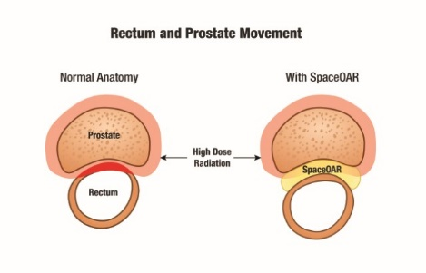
9. Injected Bioabsorbable Hydrogel
THE NEED
Radiation therapy can damage adjacent tissue and healthy organs, causing lifelong complications
In ~20% of prostate cancer patients, radiation therapy injures the rectum
WHAT IS IT?
A bioabsorbable hydrogel that is injected and temporarily positions the anterior rectal wall away from the prostate, creating about a 1 cm space to protect the rectum during radiation
Spacer maintains separation for about three months, after which it returns to a liquid state and is passed from the body through urine

Slide 25
9. Injected Bioabsorbable Hydrogel
EXPANDING USES
Augmenix reports “overwhelming demand from clinicians to receive training”
Any organs with critical adjacencies?
CONCERNS
Specific coding is not yet in place in the U.S.
Anesthesia care during placement is an additional cost

Slide 26
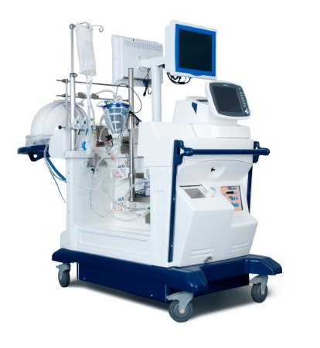
10. Warm Donor Organ Perfusion System
THE NEED
About two-thirds of donor lungs and hearts are never used because harvesting, preserving, and transporting them can damage them
WHAT IS IT?
Warm donor organ perfusion systems use warm perfusion rather than conventional cold storage after organ harvesting
Donor lungs are kept in a “near physiologic state” outside the body for up to six hours by using normothermic ex vivo lung perfusion (EVLP)

Slide 27
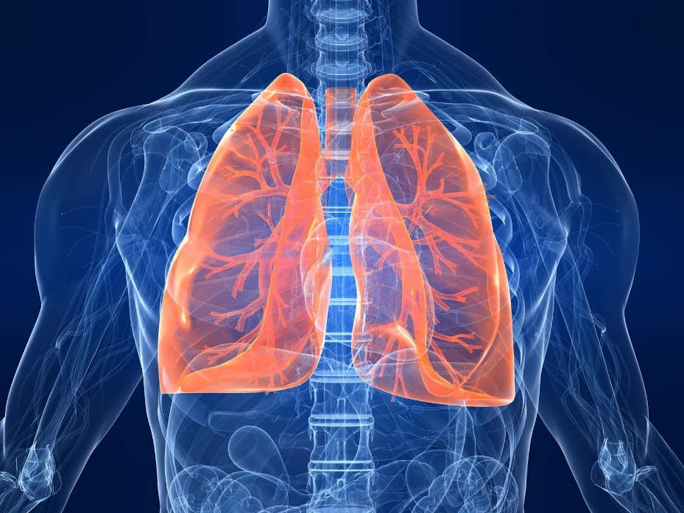
10. Warm Donor Organ Perfusion System
CLINICAL RESULTS
In a study of the XVIVO Perfusion XPS, 125 donor lungs that were initially judged to be unsuitable underwent EVLP with XPS and 103 were subsequently transplanted
In a study of the TransMedics OCS, 6-month survival benefits were reported
CONCERNS
Capital costs are high, and costs for disposables and maintenance must be considered
These have potential to double the number lung and heart transplants, so assess the increased demands on transplant staff and transplant center infrastructure

Slide 28
Common Challenges for Technology Decision-making
Choosing Technologies that Improve Outcomes
Aligning Decisions with Strategic Objectives
Having Robust and Unbiased Clinical Dialogue
Balancing Systemness with Hospital Autonomy
Timely Access to New Technology

Slide 29
Integrated Technology Decision-making Ecosystem
Strategic Technology Planning
Multi-year Capital Planning for New and Replacement Equipment
Technology Assessment
Standardized process for assessing new and emerging strategic technologies using evidence and other objective criteria.
Different approaches exist depending upon organizational culture and desires!

Slide 30
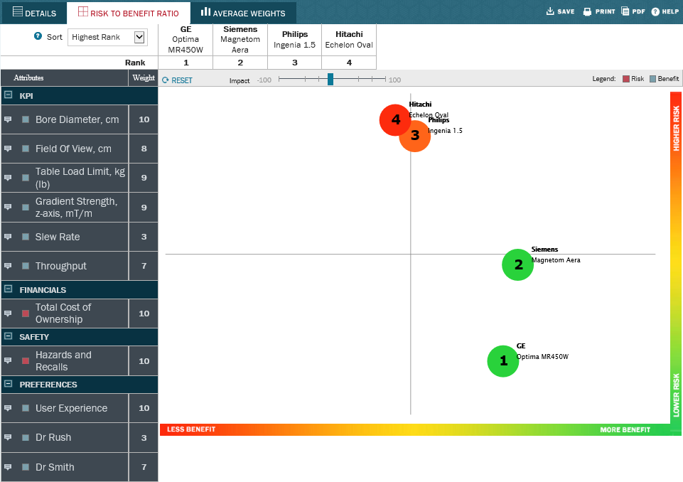
Decision Support

Slide 31
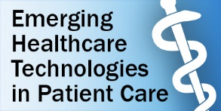
For Ongoing Technology Updates…
Ongoing technology discussions at our LinkedIn™ group:

Slide 32
Questions?
Thomas E. Skorup, MBA, FACHE
tskorup@ecri.org

